Slide 1
Chapter 9
Center of Mass

Slide 2
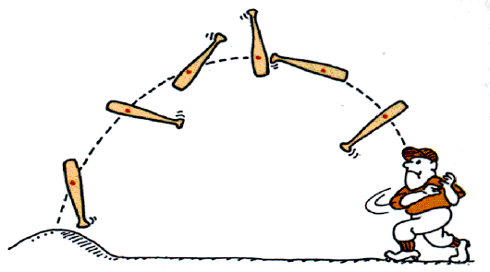
9-1 The Center of Mass
A special point
Analysis of motion can be simplified if we work with the center of mass.
The motion of the knob of a baseball bat does not follow a simple path
The center of mass of the baseball bat follows a simple parabolic path.
The other parts of the bat move around the center of mass.

Slide 3


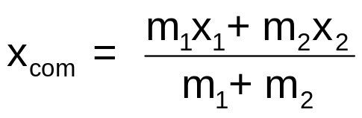
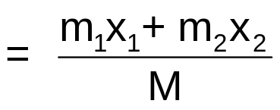






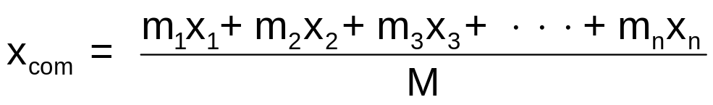
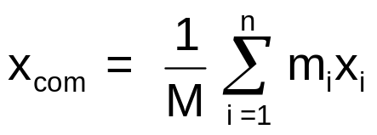
9-1 The Center of Mass
Center of mass in one dimension
The center of mass of an object is the point that moves as though
all of the object's mass were concentrated there
and
all external forces were applied there.
For two particles
The position of the center of mass
Total mass
For n particles

Slide 4
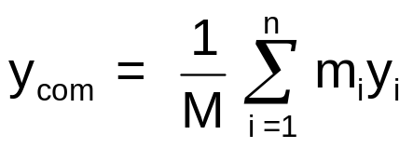
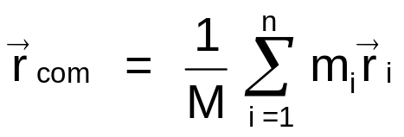
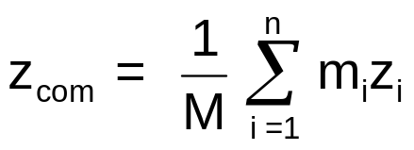
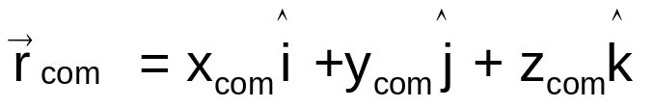
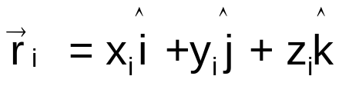
9-1 The Center of Mass
Center of mass in three dimensions
The positions of the center of mass for n particles in three dimensions are

Slide 5
9-1 The Center of Mass
Center of mass and symmetry
For objects with uniform density, we can use the symmetry of the object to locate of the center of mass.
The center of mass of a uniform sphere is the center of the sphere.
A sphere has a point of symmetry.
The center of mass of a uniform cone lies on the axis of the cone
A cone has a line of symmetry.
The center of mass need not lie within the object.

Slide 6
9-1 The Center of Mass
Checkpoint 1
A uniform square plate from which four identical squares at the corners will be removed. Where is the center of mass? Answer in terms of quadrant, axes, or points.
Solution
Solution
1
2
2
Origin
Origin
3
4
3
2
4th quadrant
3th quadrant
3
4
3
On the y axis below the origin
Origin
3
4

Slide 7











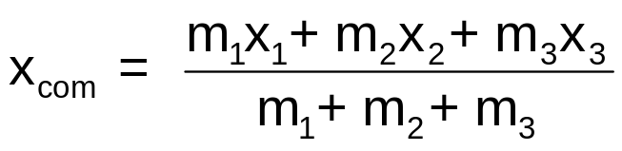

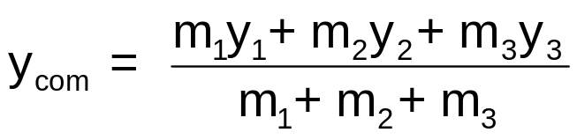

9-1 The Center of Mass
Example 1
Three particles of masses m₁ =1.2 kg, m₂ =2.5 kg, and m₃=3.4 kg form an equilateral triangle of edge length a = 140 cm. Where is the center of mass of this system?
Solution
Particle
Mass (kg)
x (cm)
y (cm)
1
1.2
0
0
2
2.5
140
0
3
3.4
70
121

Slide 8
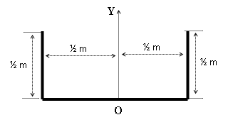
A uniform wire of mass M and length 2 m is bent to be all in one plane (see the figure). Find its center of mass with respect to point O.
a. (0 , 1/8)
b. (-1 , 1/8)
c. (1/2 , 1/3)
d. (1/8 , 3/8)
e. (1/3 , 1/3)

Slide 9
Three identical particles each of mass = 1 kg are placed in the xy plane. The position vector of the first is r₁ = (1i + 4j) m and the second is r₂ = (3i + 1j) m. What would be the position vector of the third particle if the center of mass of the three particles were at (3 m, 3 m)?
a. r₃ = (5i + 4j) m
b. r₃ = (3i - 1j) m
c. r₃ = (1i + 2j) m
d. r₃ = (2i - 6j) m
e. r₃ = (4i + 3j) m

